Slide 2
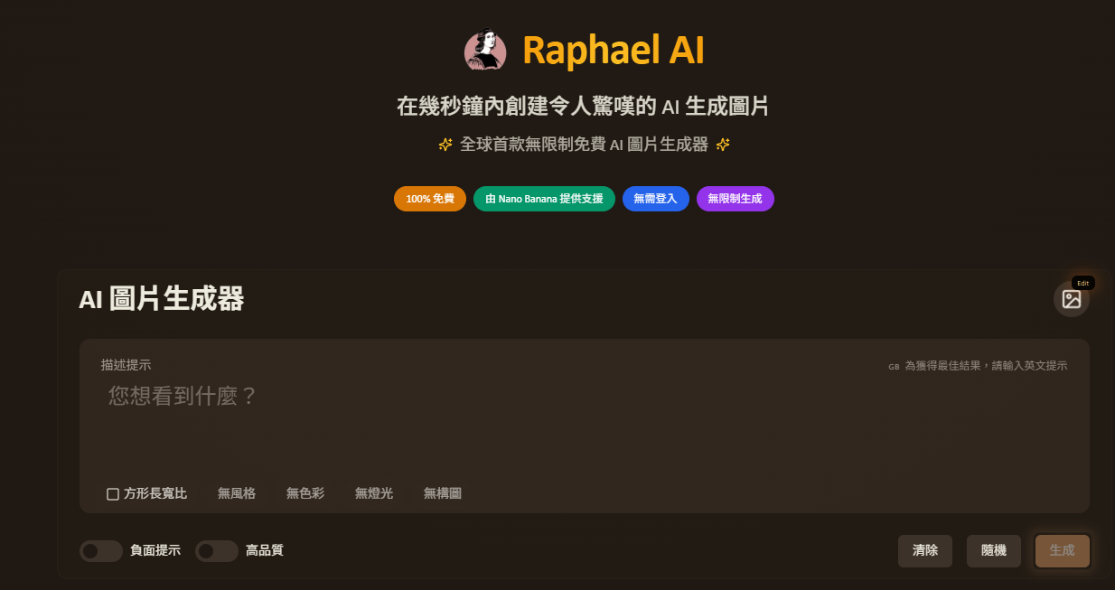
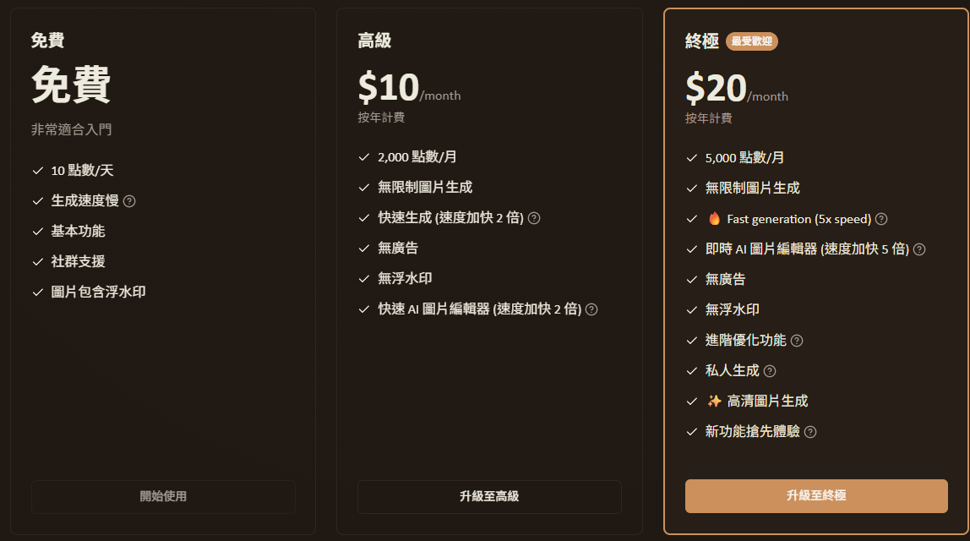
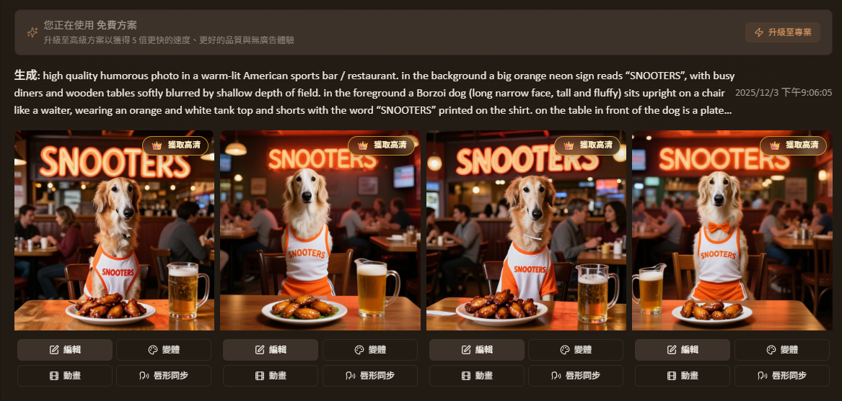
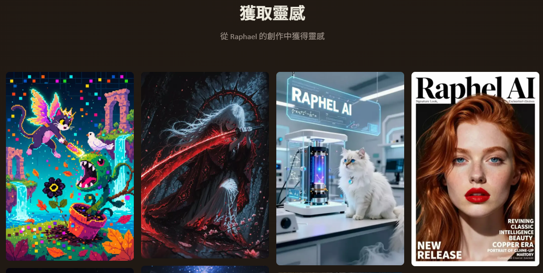
Raphael AI
生成: high quality humorous photo in a warm-lit American sports bar / restaurant. in the background a big orange neon sign reads “SNOOTERS”, with busy diners and wooden tables softly blurred by shallow depth of field. in the foreground a Borzoi dog (long narrow face, tall and fluffy) sits upright on a chair like a waiter, wearing an orange and white tank top and shorts with the word “SNOOTERS” printed on the shirt. on the table in front of the dog is a plate
https://raphael.app/zh-Hant
可支援多國語言，英文效果較好

Slide 3
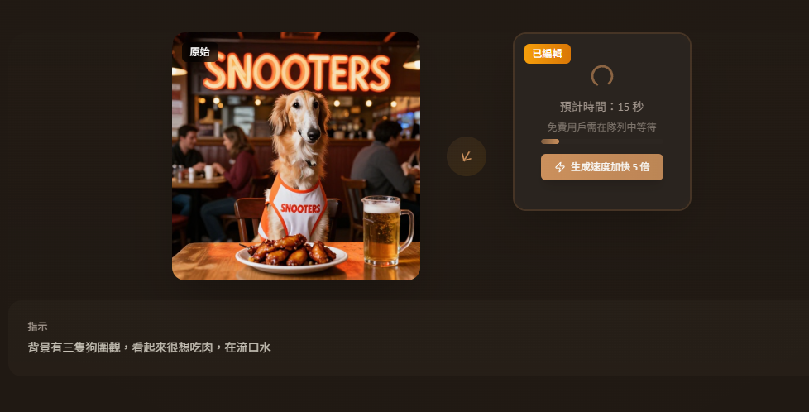
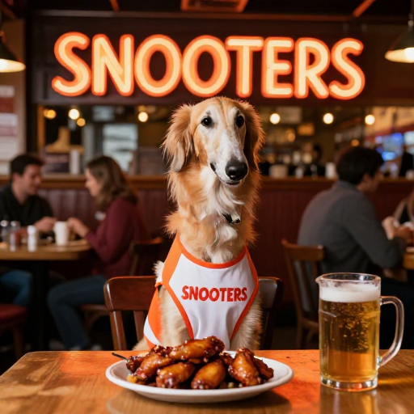
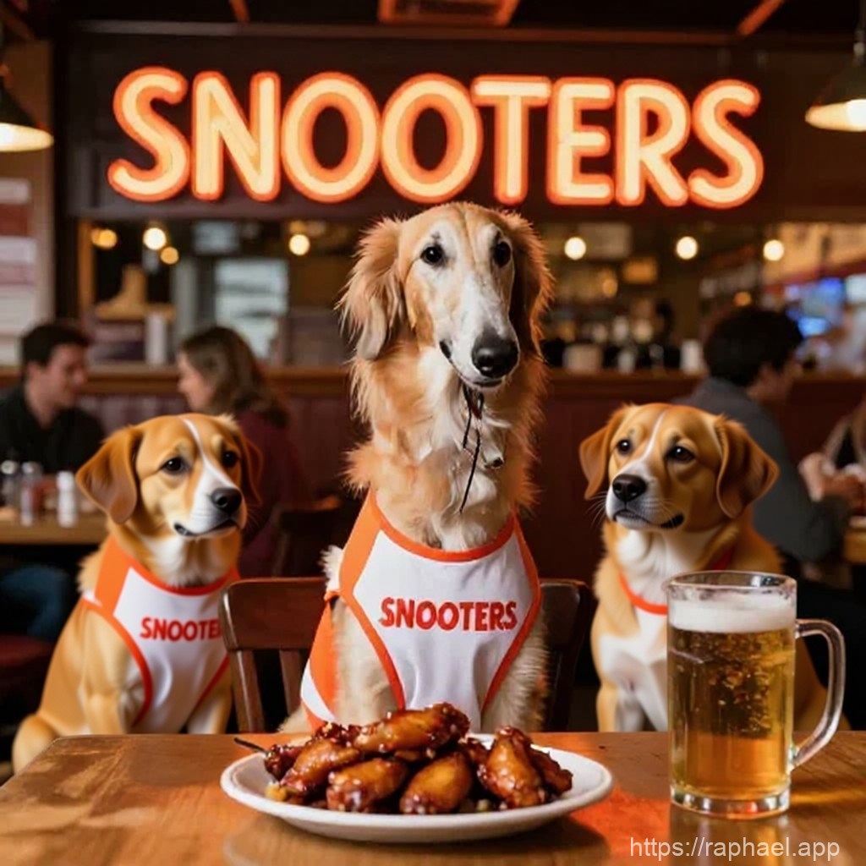
編輯圖片 加入提示詞

Slide 4
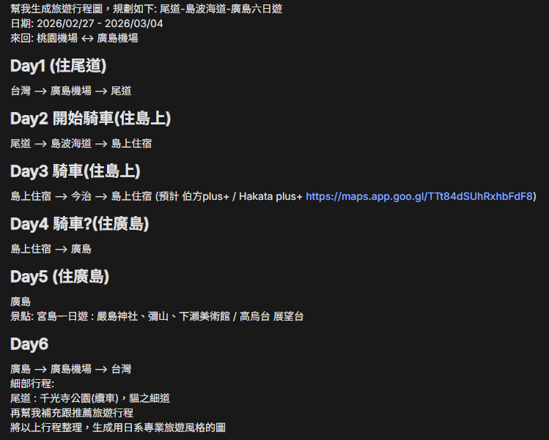
Google AI studio
Google banana

Slide 5
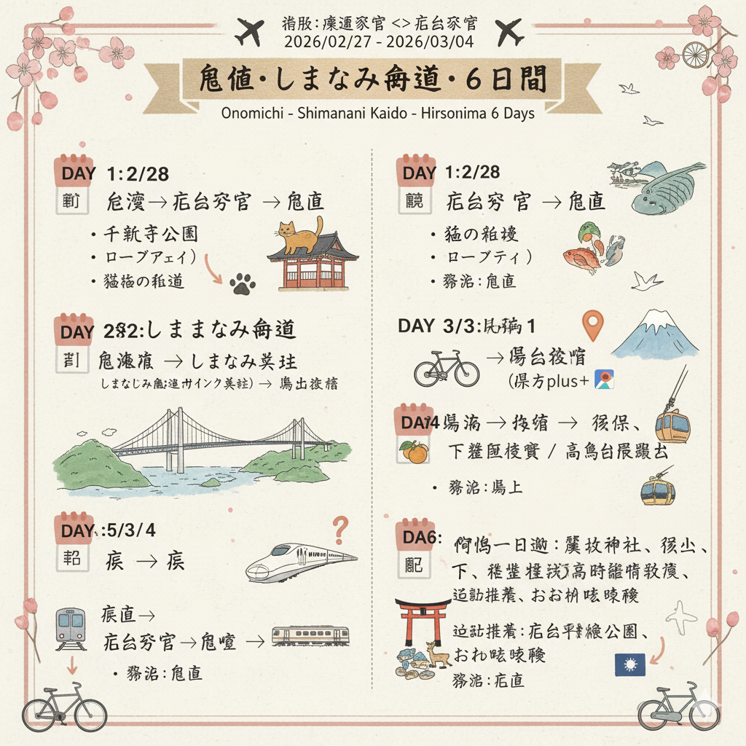
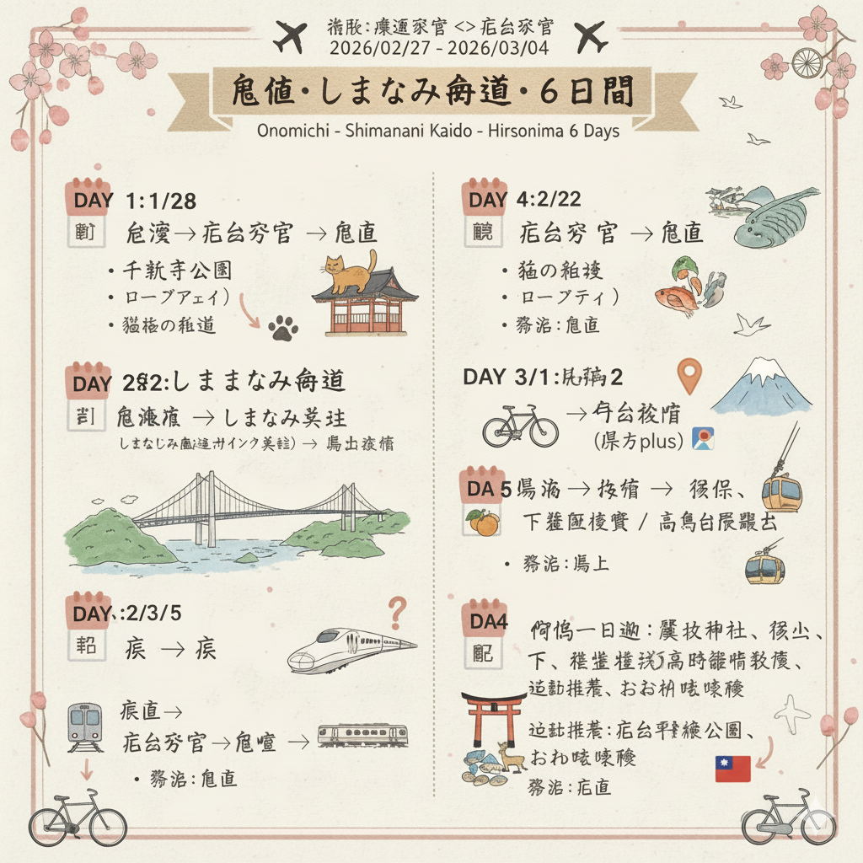
圖上的字要是中文，再修正「尾道-島波海道-廣島六日遊」行程圖，以日系專業旅遊風格呈現。

Slide 6
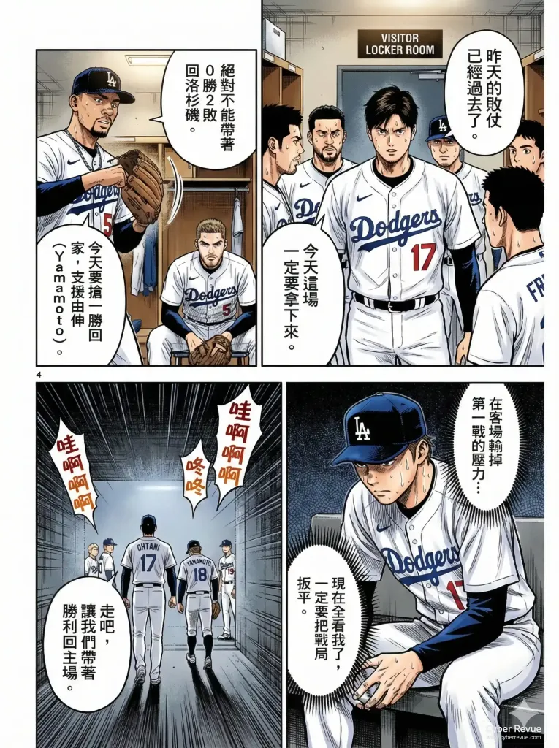
宇宙道奇 : 絕境山本
https://cyberrevue.com/yamamoto-the-dodgers-clutch-pitcher-in-do-or-die-situations/?fbclid=IwY2xjawOdJJRleHRuA2FlbQIxMABicmlkETF6NnI4T2tKN3M1NGhPWVRyc3J0YwZhcHBfaWQQMjIyMDM5MTc4ODIwMDg5MgABHtwkXQhnwd3odV5NPjVGiU03bu-pvj1n3Ih0CDkSD8jX25ae5cNYHjlMFLSs_aem_MsdjHhqVVjP-DiqiUouX0Q

Slide 7
Nano Banana 超完整攻略
https://blog.creatorhome.tw/nano-banana/#%E7%AC%AC%E5%9B%9B%E7%AB%A0%EF%BC%9A%E7%94%9F%E6%88%90%E5%BF%83%E6%B3%95%EF%BC%9Aprompt-%E6%92%B0%E5%AF%AB%E5%BF%83%E6%B3%95%E3%80%81%E5%A6%82%E4%BD%95%E6%8F%90%E5%8D%87%E5%89%B5%E6%84%8F%E8%B7%9F%E8%B3%AA%E6%84%9F%EF%BC%9F

